Slide 1
Abstract Factory

Slide 2
If an application is to be portable, it needs to encapsulate platform dependencies.

Slide 3
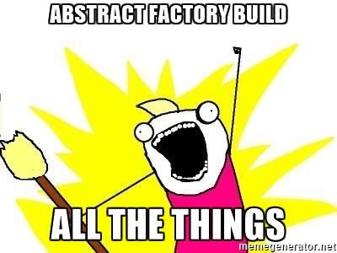
The Intent

Slide 4
Work Arounds
Use ifdef to select which functionalities to execute
Too much hassle , makes code bulky
#ifdef

Slide 5
Abstract Factory
Provide a level of indirection that abstracts the creation of families of related or dependent objects without directly specifying their concrete classes.
This mechanism makes exchanging product families easy by instantiating a different concrete instance of the abstract factory.
Notes:
Provide a level of indirection that abstracts the creation of families of related or dependent objects without directly specifying their concrete classes. The "factory" object has the responsibility for providing creation services for the entire platform family. Clients never create platform objects directly, they ask the factory to do that for them. This mechanism makes exchanging product families easy because the specific class of the factory object appears only once in the application - where it is instantiated. The application can wholesale replace the entire family of products simply by instantiating a different concrete instance of the abstract factory.

Slide 6
Structure

Slide 7
The Abstract Factory defines a Factory Method per product. Each Factory Method encapsulates the new operator and the concrete, platform-specific, product classes. Each "platform" is then modeled with a Factory derived class.

Slide 8
Interface and concrete classes
An interface will provide a collection of abstract methods. The concrete class will implement the interface and override the abstract methods to provide class specific functionality.
Eg:
Interface Shape
Concrete class Rectangle
Concrete class Circle
Concrete class Triangle
Concrete classes implement the interface.

Slide 9
AbstractFactory and Factory
In Abstract Factory pattern an interface is responsible for creating a factory of related objects without explicitly specifying their classes. Each generated factory can give the objects as per the Factory pattern.
Eg: Abstract AbstractFactory class will define and abstract the class instantiation &
Factory class will extend the abstract class and override its functions to return objects of the concrete class.

Slide 10
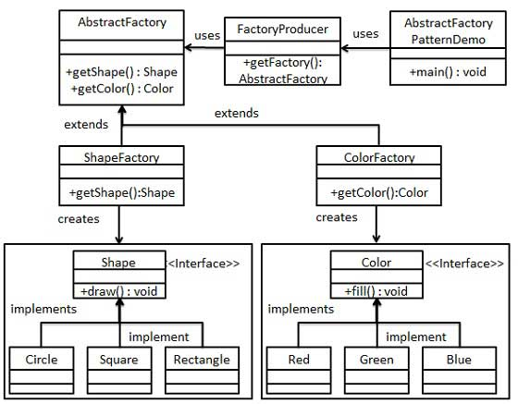
Diagram

Slide 11
Abstract Example

Slide 12
The purpose of the Abstract Factory is to provide an interface for creating families of related objects, without specifying concrete classes. This pattern is found in the sheet metal stamping equipment used in the manufacture of Japanese automobiles.
Notes:
This pattern is found in the sheet metal stamping equipment used in the manufacture of Japanese automobiles. The stamping equipment is an Abstract Factory which creates auto body parts. The same machinery is used to stamp right hand doors, left hand doors, right front fenders, left front fenders, hoods, etc. for different models of cars. Through the use of rollers to change the stamping dies, the concrete classes produced by the machinery can be changed within three minutes.

Slide 13
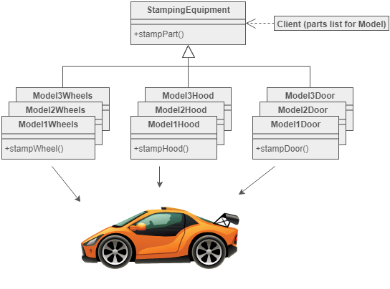

Japanese Car Factory

Slide 14
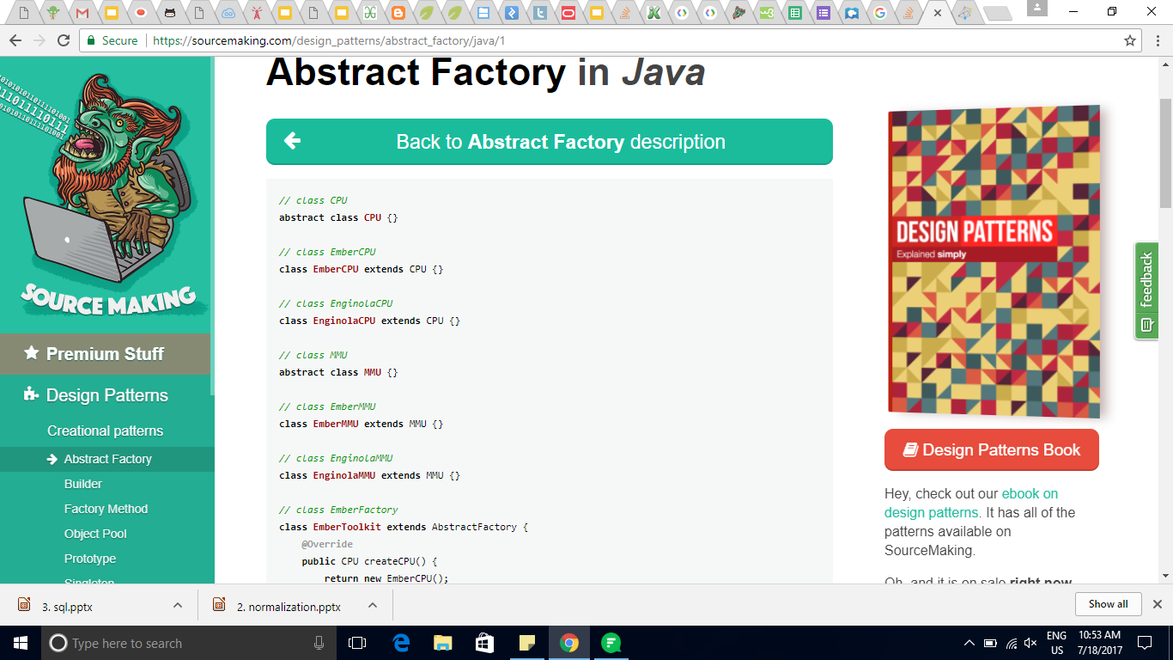
Example

Slide 15
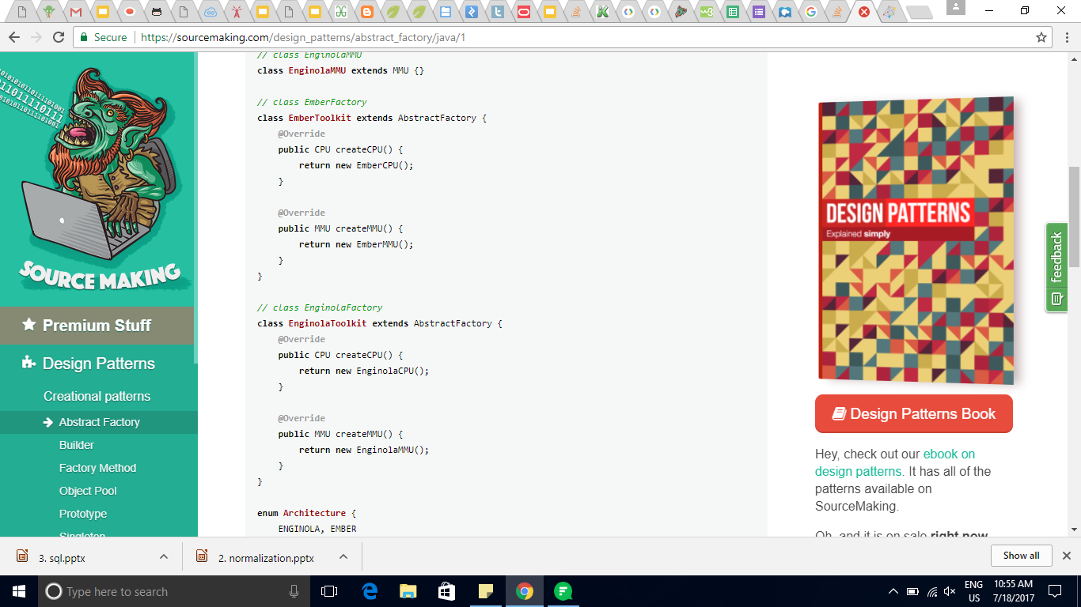
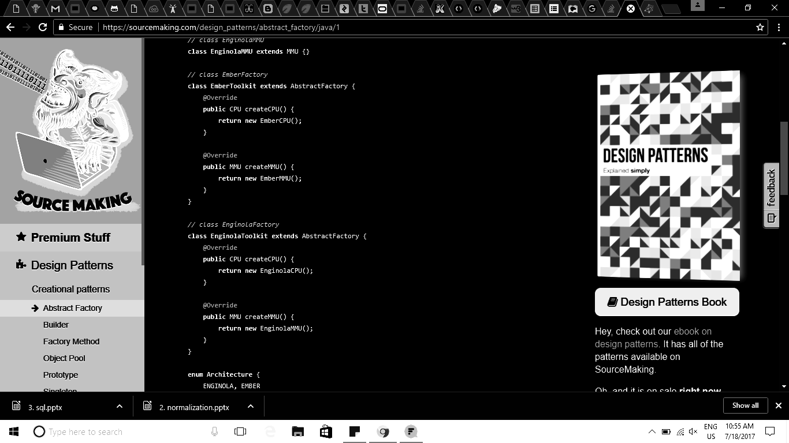
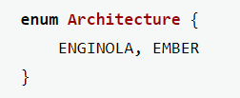

Slide 16
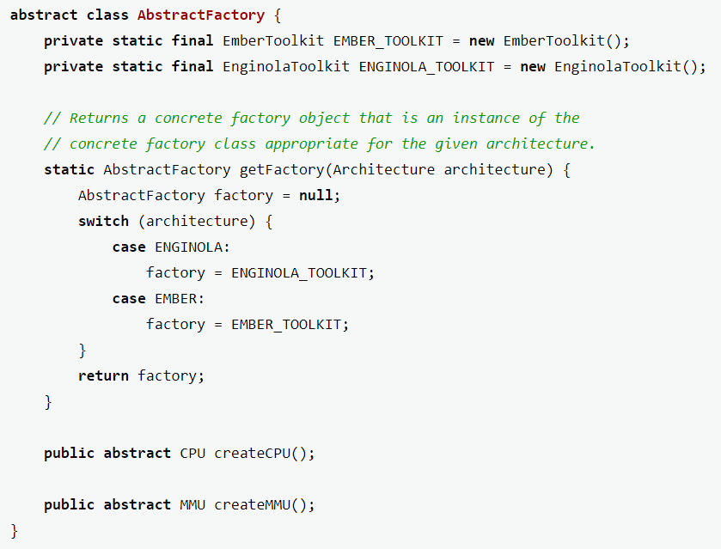

Slide 17
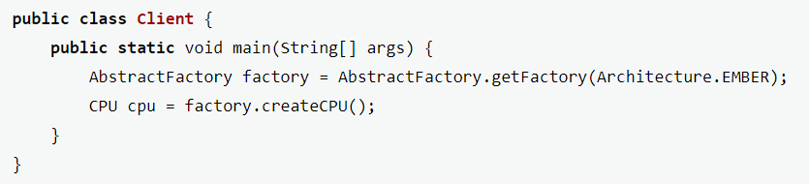

Slide 18
Checks:
1. Factory method per product
2. Family of factory methods
3. Hide platform specific details
4. Flexibility
5. Encapsulates references to the ‘new’ operator

Slide 19
Thank you! :)

